Slide 1
Indoor WLAN Based Localization

Slide 2
Objective
To create an indoor tracking system that can be implemented in mobile Zebra devices.

Slide 3
Benefits to Zebra
Possible applications include:
Autonomous guiding through commercial buildings (i.e. hospitals, office buildings, department stores, warehouses).
Locating lost or misplaced devices.
Tracking workers through office buildings (i.e. locating mailroom employees).
Locating injured people in case of an emergency.
Beam-forming for efficient wireless charging.
Tracking customers in a retail environment to improve analytics.

Slide 4
Demonstration
Ball Tracking:
https://www.youtube.com/watch?v=j5h95g_ifCk
Color Tracking:
https://www.youtube.com/watch?v=SV6CmEha51k

Slide 5
Prior Works
Improving Wi-Fi Based Indoor Positioning using Particle Filter based on Signal Strength, Sakib et al.
In 400m² room, mean error of 2.41m using 4 APs and fingerprinting.
Indoor User Tracking with Particle Filter, Kim et al.
Mean error of 0.94-1.2m along 3 possible paths, ranging number of APs.

Slide 6
Proposed Method (High Level)
Perform fingerprinting of RSS throughout proposed area.
Implement a particle filter to perform tracking based off of RSS measurements.

Slide 7
Proposed Method (Technical)
Develop Android application which can measure the received signal strength for all available APs in an area, as well as collect gyroscope and accelerometer data.
Perform fingerprinting over approximately 16m².
Take 3-10 measurements at each point. Save all data, then later on take sample mean for each point.
Load this data into Python, and form different simulation models. Find the most accurate set of equations of motion for the system.
Classify motion as static or dynamic using accelerometer data.
Perform sequential importance resampling for dynamic class, and sequential importance sampling for static class.
For the dynamic class, explore different sets of state equations. Refer to prior work, as well as outside sources.
Perform field tests using the Android device, a laptop, and Python implementation.
Implement proposed algorithms in Java and deploy on Zebra devices.

Slide 8
Tools Required
Laptop. ✓
Python. ✓
Google. ✓
Android device.
Android programmer.

Slide 9
Offline Python Simulation
Place 4 APs throughout a 1400m² room.
Form grid of specified unit area throughout room.
For each node in the grid, calculate distance from each AP.
Apply log-normal path loss model to simulate RSSI from each AP at each node. Use this as fingerprint.
Iterate this process 20 times, then take the average fingerprint.
Convolve the final fingerprint with a uniform kernel.
Simulate a trajectory.
Sample points from trajectory.
Calculate distance at each sample point from each AP.
Path Loss Model:

Slide 10
Online Python Simulation
Given the distance of the sampled points on the trajectory from each AP, simulate 3-10 RSSI measurements, then average to form final sample point RSSI.
We can average because as long as the device has moved 12.5cm (2.4G), or 6cm(5G), the noise in the path loss is considered independent and identically distributed (Puccinelli).
Find the most likely position of each point on the trajectory by minimizing the mean squared error across each node of the grid.
This position will be the observation process in the particle filter.
Use particle filter to estimate current state.
Generate two dependent Gaussian random variables ( ), using Box-Muller Transformation:
Plug these random variables into dynamics equations:

Slide 11
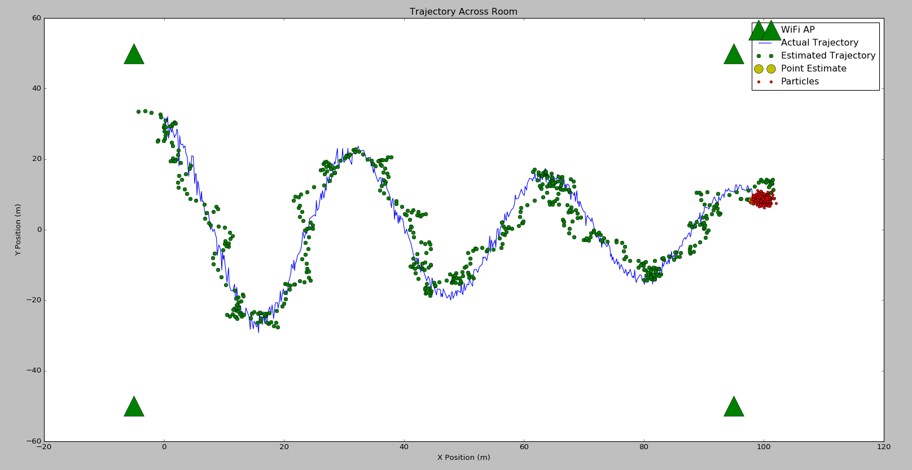
Trajectory (Weighted Sum of Particles)

Slide 12
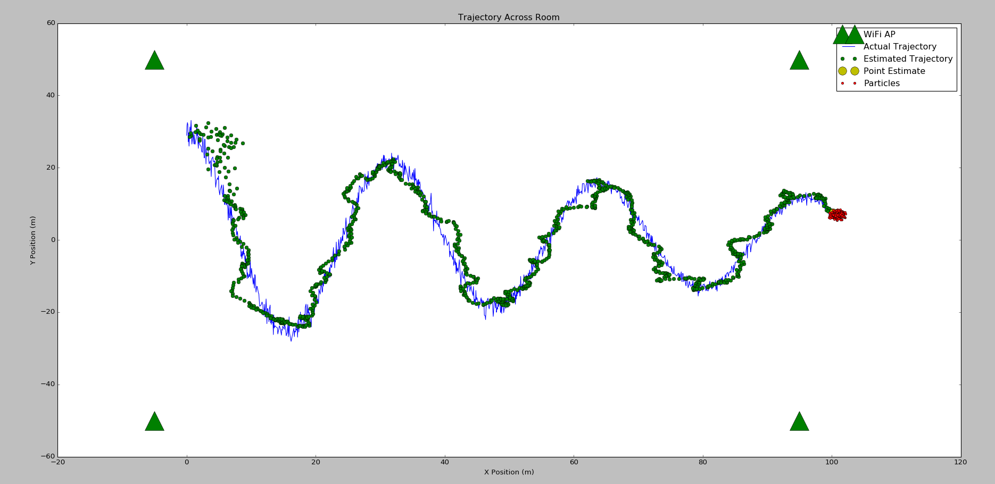
Trajectory (Weighted Sum of Particles with ARMA)

Slide 13
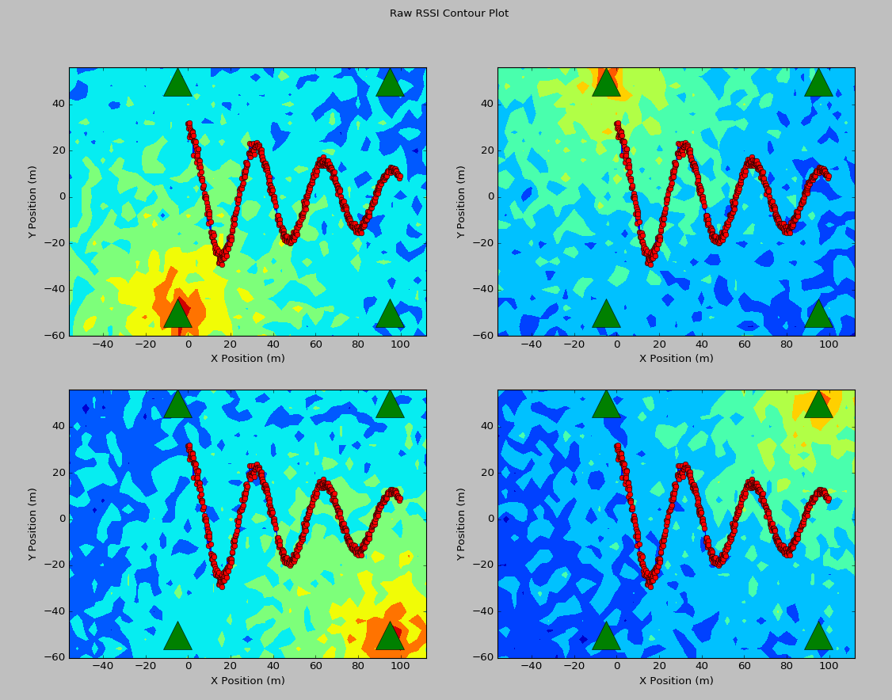
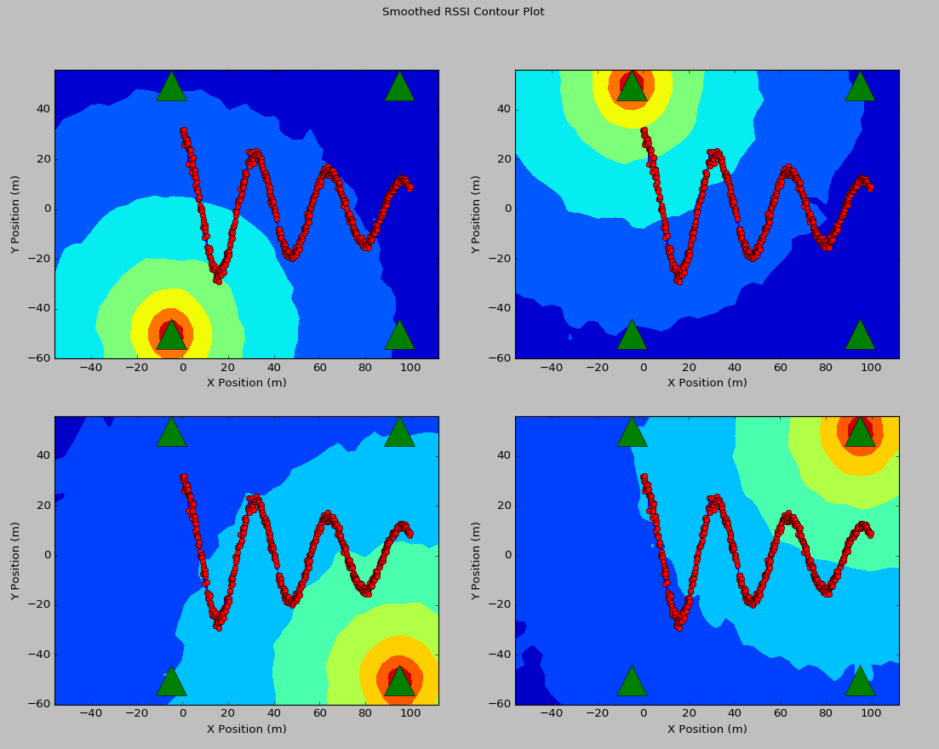
Fingerprint of Individual APs

Slide 14
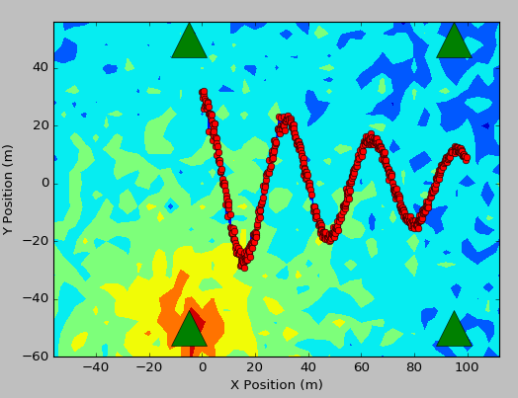
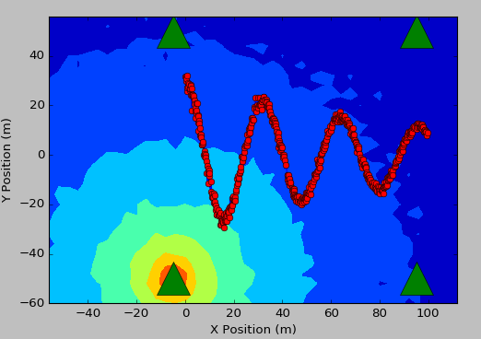
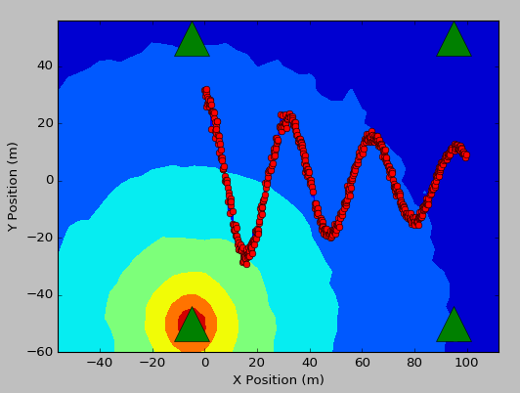
FP Comparison
Offline Averaging
Convolution Smoothing

Slide 15
Simulation Results (4 dB Standard Deviation)
Path-loss STD (dB) | Number of Online Samples | Sampling Frequency (Hz) | WS Estimate ME (m) | MAP Estimate ME (m) | WMAP Estimate ME (m) | FP Estimate ME (m) | ARMA Estimate ME (m)
4 | 3 | 8 | 3.57 | 3.58 | 3.56 | 8.83 | 4.35
4 | 3 | 16 | 2.92 | 2.93 | 2.89 | 9.34 | 2.6
4 | 3 | 32 | 2.86 | 2.87 | 2.82 | 9.26 | 2.15
4 | 3 | 64 | 2.89 | 2.9 | 2.85 | 9.2 | 2.11
4 | 5 | 8 | 3.03 | 3.06 | 3.03 | 7.15 | 3.98
4 | 5 | 16 | 2.77 | 2.78 | 2.74 | 7.2 | 2.47
4 | 5 | 32 | 2.51 | 2.53 | 2.48 | 7.17 | 1.93
4 | 5 | 64 | 2.49 | 2.52 | 2.46 | 7.19 | 1.72
4 | 10 | 8 | 2.74 | 2.77 | 2.74 | 5.39 | 3.83
4 | 10 | 16 | 2.26 | 2.3 | 2.24 | 5.13 | 1.89
4 | 10 | 32 | 2.18 | 2.23 | 2.15 | 5.11 | 1.51
4 | 10 | 64 | 2.18 | 2.23 | 2.17 | 5.14 | 1.46

Slide 16
Simulation Results (7.36 dB Standard Deviation)
Path-loss STD (dB) | Number of Online Samples | Sampling Frequency (Hz) | WS Estimate ME (m) | MAP Estimate ME (m) | WMAP Estimate ME (m) | FP Estimate ME (m) | ARMA Estimate ME (m)
7.36 | 3 | 8 | 7.06 | 7.05 | 7.05 | 19.01 | 8.15
7.36 | 3 | 16 | 4.4 | 4.41 | 4.39 | 17.91 | 4.14
7.36 | 3 | 32 | 4.28 | 4.28 | 4.24 | 17.76 | 3.78
7.36 | 3 | 64 | 4.12 | 4.13 | 4.09 | 17.56 | 3.44
7.36 | 5 | 8 | 4.01 | 4.02 | 4.01 | 13.03 | 4.92
7.36 | 5 | 16 | 4.05 | 4.05 | 4 | 14.12 | 3.94
7.36 | 5 | 32 | 3.59 | 3.59 | 3.56 | 13.43 | 2.94
7.36 | 5 | 64 | 3.49 | 3.5 | 3.46 | 13.55 | 2.79
7.36 | 10 | 8 | 3.27 | 3.29 | 3.25 | 9.02 | 4.14
7.36 | 10 | 16 | 2.89 | 2.91 | 2.88 | 9.15 | 2.71
7.36 | 10 | 32 | 2.91 | 2.93 | 2.89 | 9.37 | 2.19
7.36 | 10 | 64 | 2.91 | 2.92 | 2.87 | 9.53 | 2.11

Slide 17
Demonstration

Slide 18
Advantages of WLAN Locationing
Requires no additional infrastructure.
WiFi APs are already present in commercial buildings.
Requires no additional hardware.
All mobile computers already have the required hardware to perform WLAN locationing.
Easy to calibrate.
Fingerprint a location by simply navigating through the area with an application running to record RSSI, as well as current location.

Slide 19
Considerations
Can RSS actually be modeled as an IID process?
Yes: Take more samples, average better accuracy.
No: Talk to RF expert for opinion.
How much computing power can we spare to use on devices?
Consider using GPU. Most of this can be parallelized, which is ideal for GPUs.
GPUs consume almost the same amount of power whether they’re idling or performing computations.
Consider using the cloud for computation.
Information from accelerometer and gyroscope.
This data might be very informative and can be incorporated into a model.
Possibly Rao-Blackwellized Particle Filter.

Slide 20
References
Improving Wi-Fi Based Indoor Positioning using Particle Filter based on Signal Strength, Sakib et al.
A Tutorial on Particle Filters for Online Nonlinear/ Non-Gaussian Bayesian Tracking, Arulampalam et al.
On Sequential Monte Carlo Sampling Methods for Bayesian Filtering, Doucet et al.
Modeling Signal Attenuation in IEEE 802.11 Wireless LANs, Faria et al.

